Slide 1
DevOps with the Microsoft Stack
Abel Wang
Sr Technical Product Marketing Manager for
.NET, Mobile and DevOps
abel.wang@microsoft.com | @abelsquidhead |
http://abelsquidhead.com

Slide 2
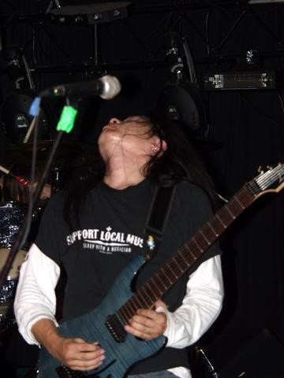


Who am I?
Abel Wang | @AbelSquidHead
Sr Technical Product Marketing Manager for .NET, Mobile and DevOps
Blog at abelsquidhead.com
abel.wang@microsoft.com
Work
Writing code for over 20 years
Process Consultant/Certified Scrum Master
ALM Ranger
VSTS Team
DevOps, General App Dev, Mobile, Visual Studio, Azure
Fun Stuff
Rock star in his own mind
Training for the Great Wall Marathon

Slide 3






DevOps: the three stage conversation
DEV
OPS
1
People
2
Process
3
Products
Notes:
People = Culture
Fundamental attributes of successful cultures:
Shared mission and incentives: infrastructure as code, apps as services, DevOps/all as teams
You need to consider your hardware as a commodity, (don't give your servers names) , servers are like farm animals, it is just harder if you let theids name them
Build deep instrumentation into services, push complexity up the stack
Rally around agile, shared metrics, CI, service owners on call, etc.
Changing the culture: any change takes time, changing culture is no exception and you can't do it alone, exploit compelling events to change culture: downtimes, cloud adoption, devops buzz
PROCESS Definition and design, compliance, and continuous improvement
PEOPLE Responsibilities, management, skills development, and discipline
Products Tools and infrastructure

Slide 4
Process
1
4
Plan
Monitor + Learn
Development
Production
2
3
Develop + Test
Release

Slide 5

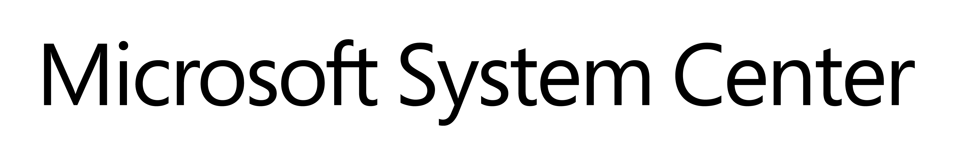




Products/Services
Source control
TFS/VSTS
Agile planning
+ Azure
Test case management
Build automation
Continuous deployment
Release management
Load testing
Feedback management
Team collaboration
Application telemetry
Lab management

Slide 6
What is Visual Studio Team Services?
It’s a source control system!
Wrong. It is FAR more than a source control system.
Everything you need to create software. From application inception to application sun setting.
DevOps Collaboration Hub
Key Functional Areas
Agile Planning & Management/Work Item Tracking
Version Control
Build Management & Automation
Testing
Release Management
Application Monitoring

Slide 7

Enabling Value Delivery
Plan
REQUIREMENTS
Backlog
Continuous Learning throughout the lifecycle
Agile Planning
Business
Product Owners
+ all other
Stakeholders
Collaborative Team Experiences
Development
Production
Automated
Dev and Test Tools
Developers
Testers
Operations
Flexibility, Extensibility,
Hybrid IT capable
Visibility, Traceability during whole Lifecycle
Develop + Test
Release
Build & Release

Slide 8
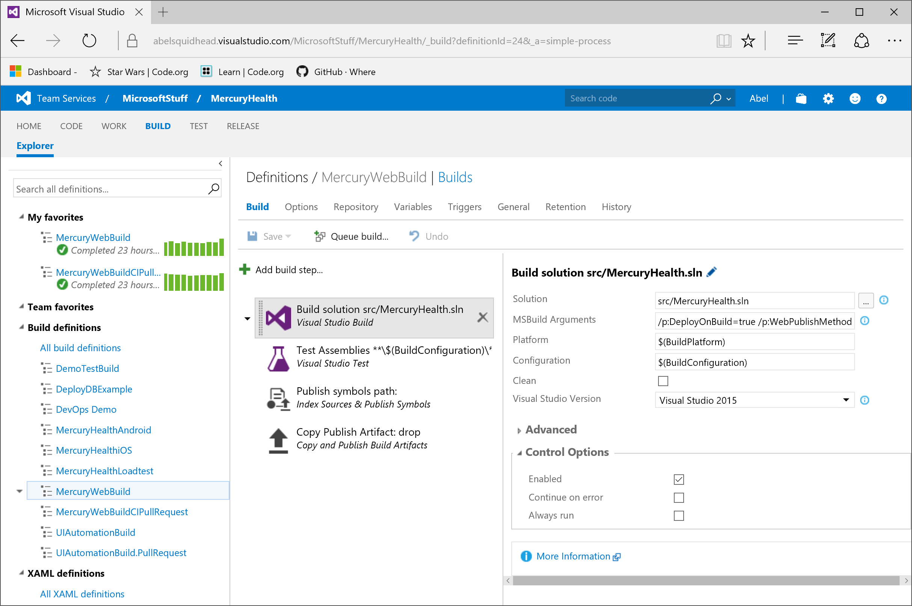
Cross Platform Build System

Slide 9
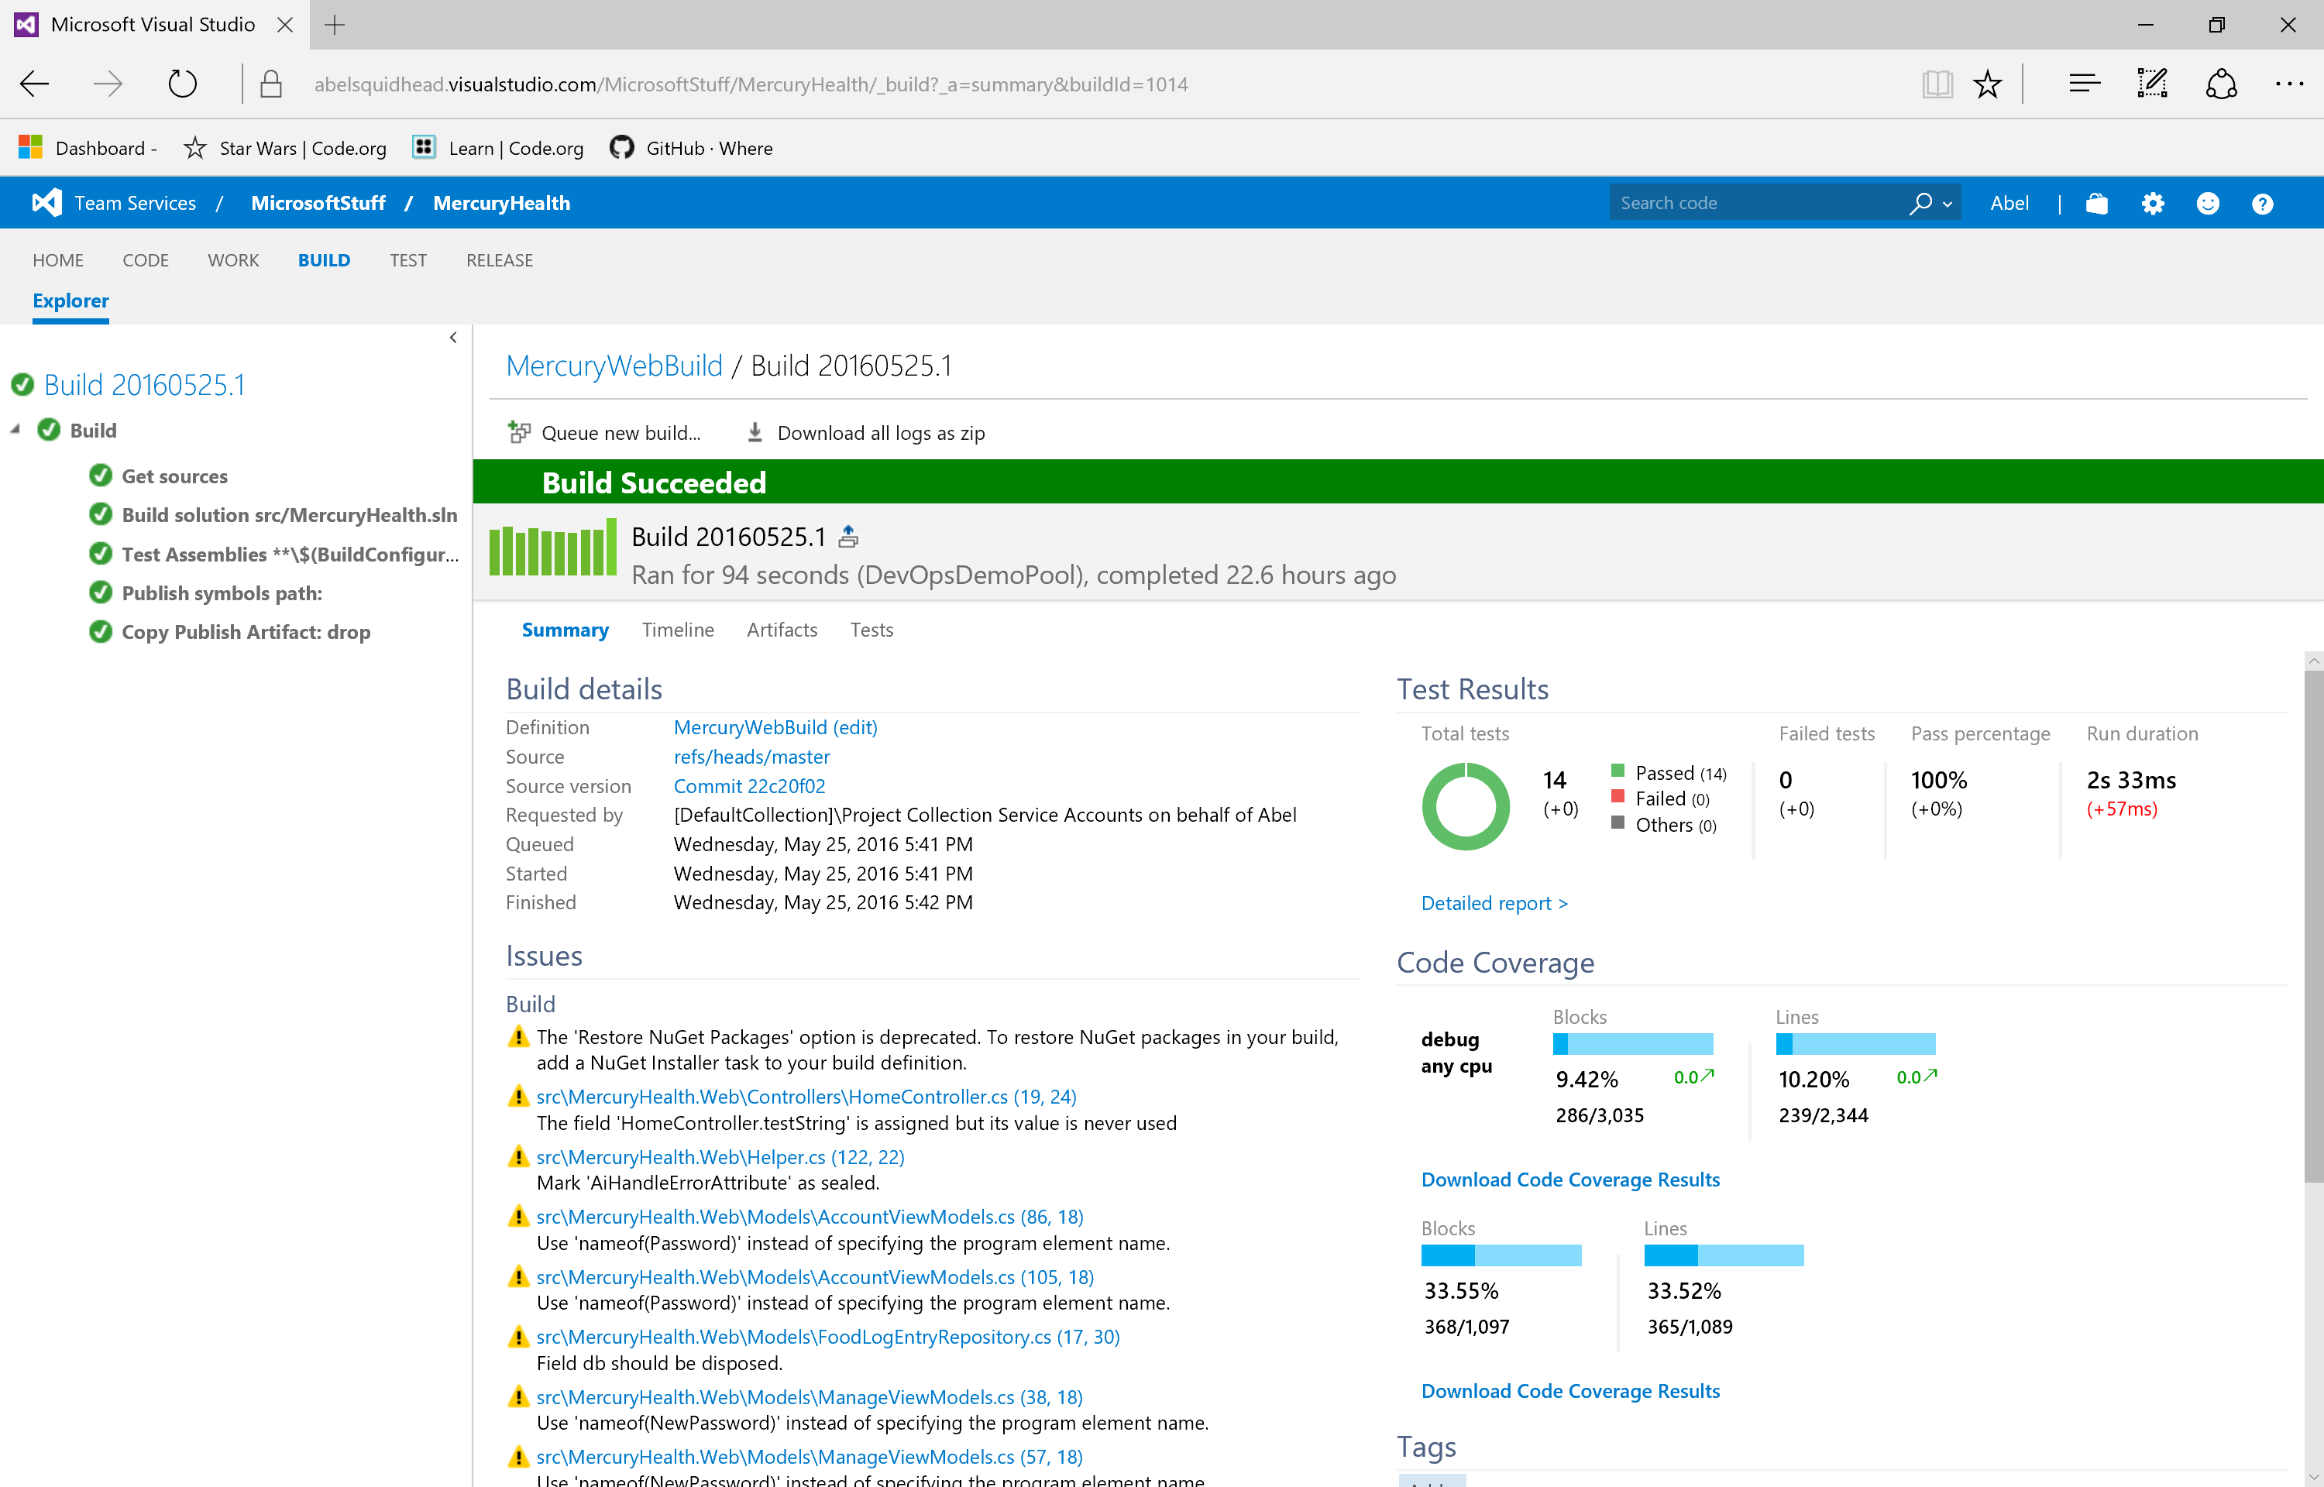
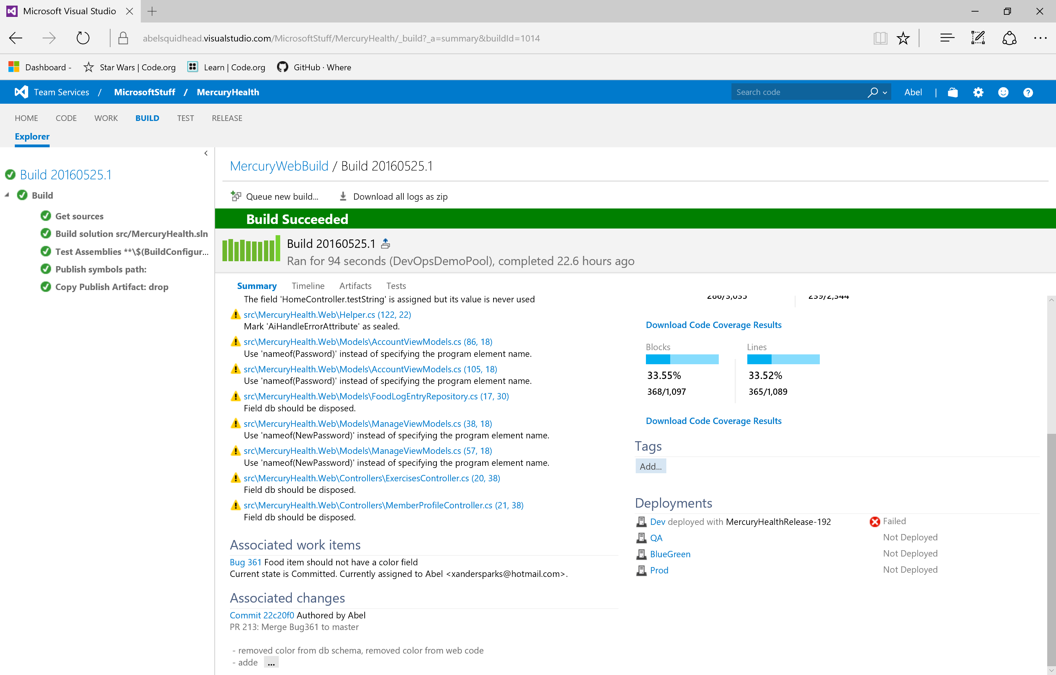
Build Reports

Slide 10
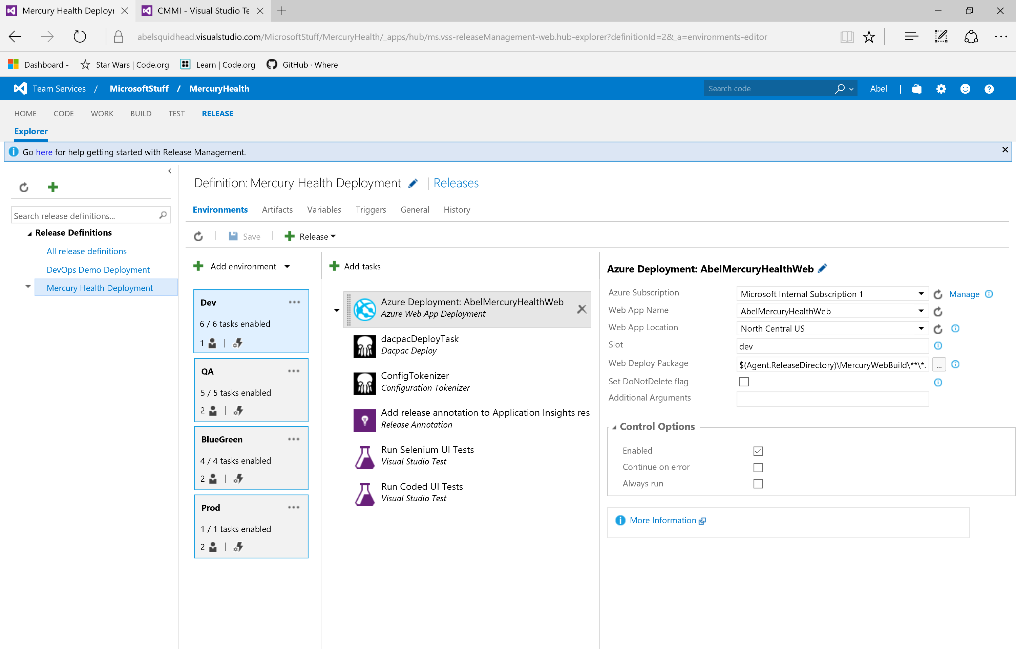
Release Management

Slide 11
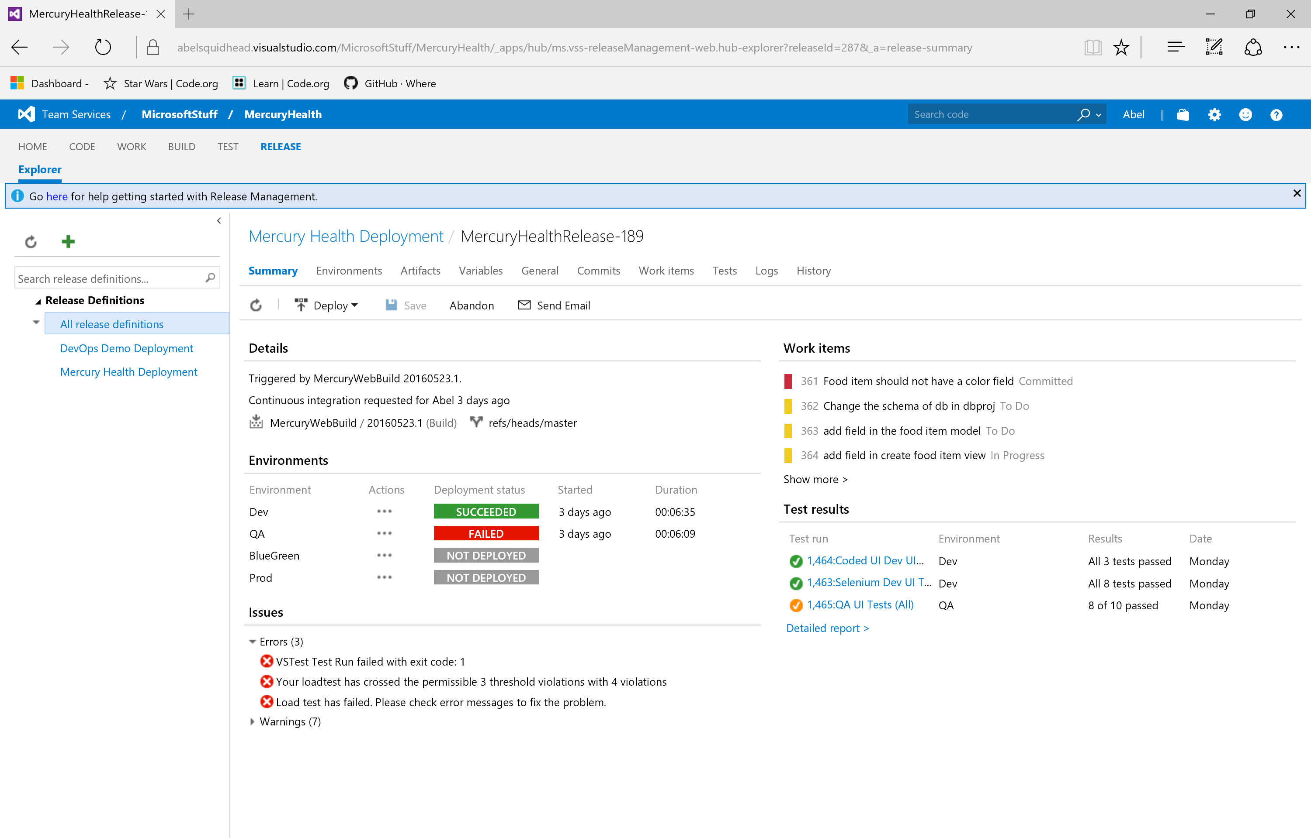
Release Management Summary

Slide 12
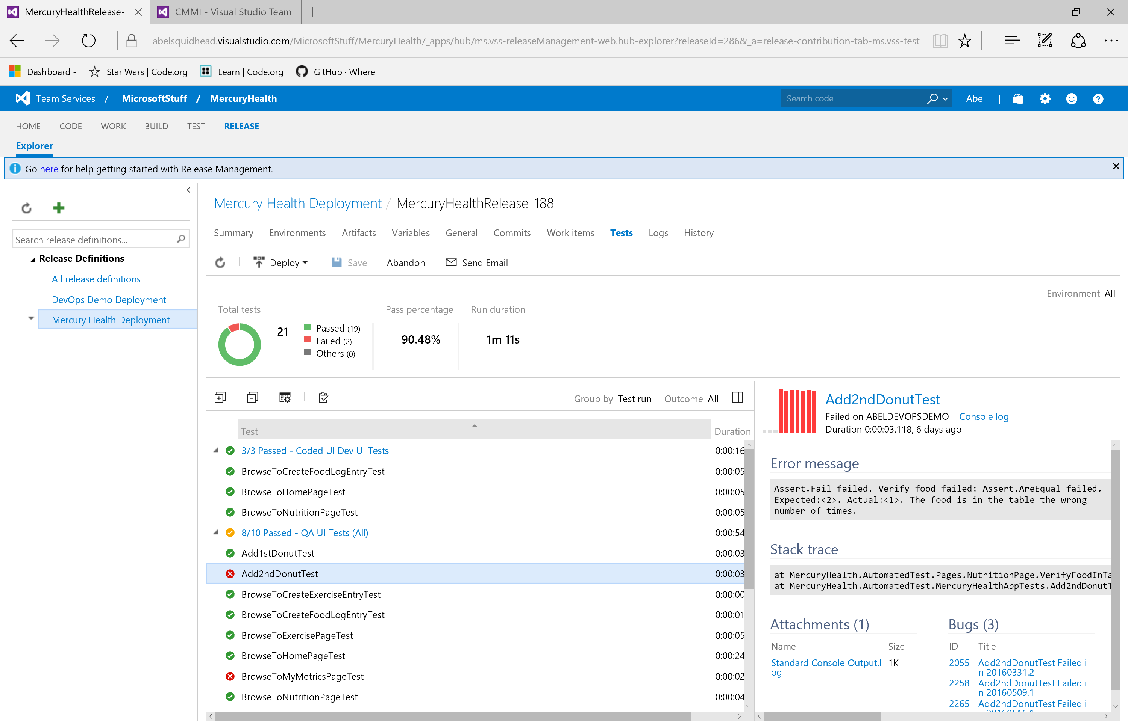
Release Management Testing Effort

Slide 13
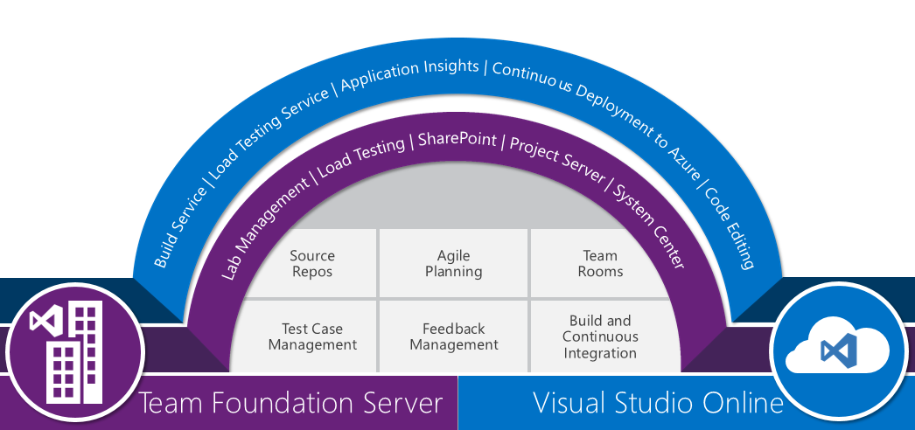
Microsoft ALM/DevOps Hub
Notes:
Review ALM Features

